Slide 1
Slide 12
Object and Class
Dasar-Dasar Pemrograman 1
Semester Ganjil 2016/2017

Slide 2
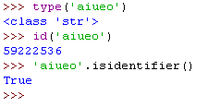
Objects
So far, our programs have made use of objects created from pre-defined class such as str
Here we’ll learn how to write our own classes to create novel objects / data structure
Dasar-Dasar Pemrograman Ganjil 2016-2017

Slide 3
Objects
An object can be considered as an active data type that knows stuff and can do stuff
More precisely, an object consist of:
  A collection of related information
  A set of operations to manipulate that information
Dasar-Dasar Pemrograman Ganjil 2016-2017

Slide 4
Objects
A class defines the properties and behaviors for objects
An object is an instance of a class
We can create many instances of a class
Creating an instance of a class if referred to as instantiation
A class is a description of what its instance will know and do
Dasar-Dasar Pemrograman Ganjil 2016-2017

Slide 5
Objects
The information is stored inside the object in instance variables / data fields
The operations, called methods, are functions that “live” inside the object
Collectively, the instance variables and methods are called the attributes of an object
Dasar-Dasar Pemrograman Ganjil 2016-2017

Slide 6
Class Definition
Class definition have the form:
  class <class-name> (<superclass>, …):
  <variable and method definitions>
Methods look a lot like functions. Placing the function inside a class makes it a method of the class, rather than a stand alone function
The first parameter of a method is usually named self, which is a reference to the object on which the method is acting
Dasar-Dasar Pemrograman Ganjil 2016-2017

Slide 7
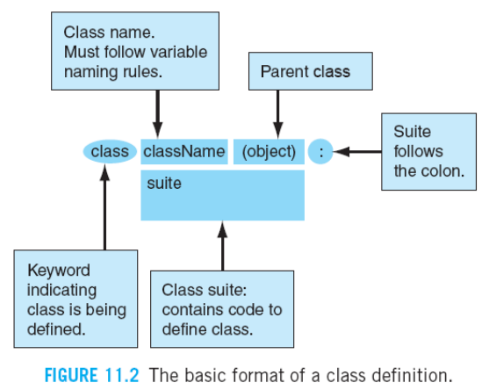
Class definition
Dasar-Dasar Pemrograman Ganjil 2016-2017

Slide 8
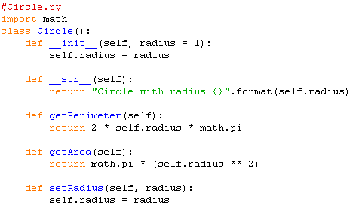
Example
Dasar-Dasar Pemrograman Ganjil 2016-2017

Slide 9
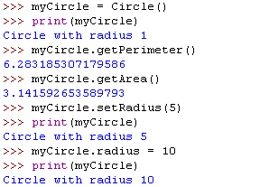
Example (1)
Dasar-Dasar Pemrograman Ganjil 2016-2017

Slide 10
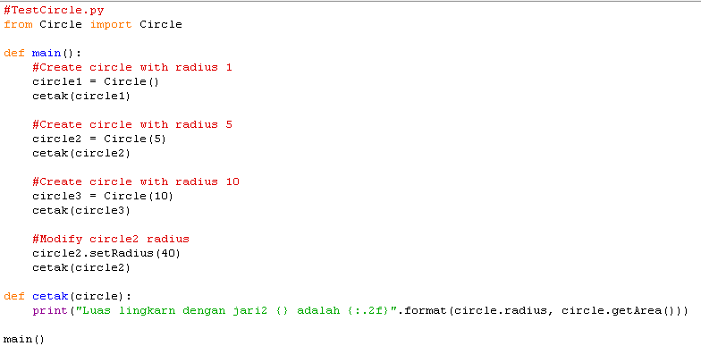
Example (2)
Dasar-Dasar Pemrograman Ganjil 2016-2017

Slide 11

Example (3)
Output:
Dasar-Dasar Pemrograman Ganjil 2016-2017

Slide 12
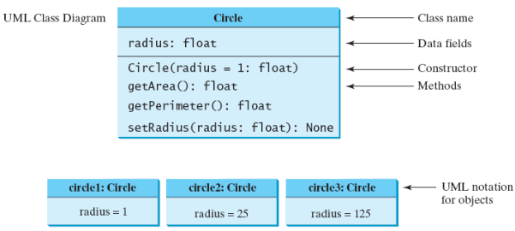
Design of the Circle object
Dasar-Dasar Pemrograman Ganjil 2016-2017

Slide 13

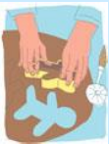

Class vs Instance
It’s very important to understand what class is and what an instance of a class is
Class: blueprint/prototype
Instance: Individual object of a class
The analogy of the cookie cutter and a cookie
Dasar-Dasar Pemrograman Ganjil 2016-2017

Slide 14
Class as Template
You define a class as a template to generate new instances (objects) of that class
The structure of an instance starts out the same, as dictated by the class
The instances responds to the messages (methods) defined as part of the class
Dasar-Dasar Pemrograman Ganjil 2016-2017

Slide 15
Why a class
We make classes because we need more user-defined model to represent real-world problem/object
Each class has potentially two aspects:
  The data (types, number, names) that each instance might contain
  The messages/methods that each instance can respond to
Dasar-Dasar Pemrograman Ganjil 2016-2017

Slide 16
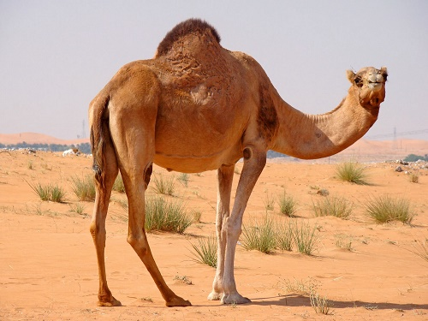
Standard class names
The standard way to name a class in Python is called CapWords:
  Each word of a class begins with a Capital letter
  No underscores
  Sometimes called CamelCase
  Make recognizing a class easier
Dasar-Dasar Pemrograman Ganjil 2016-2017

Slide 17
Constructor
When a class is defined, a function is made with the same name as the class
This function is called constructor. By calling it, you can create an instance of the class
Constructor
Dasar-Dasar Pemrograman Ganjil 2016-2017

Slide 18
Dot reference
We can refer to the attributes of an object by doing a dot reference, of the form:
  object.attribute
The attribute can be a variable or a method
It is part of the object
Dasar-Dasar Pemrograman Ganjil 2016-2017

Slide 19

Examples
Print a variable associated with the object:
Call a method associated with the object
Variable vs method: you can tell by the parentheses at the end of the expression
Dasar-Dasar Pemrograman Ganjil 2016-2017

Slide 20
Exercise
Buatlah sebuah Class yang merepresentasikan mobil berdasarkan keterangan berikut:
  Setiap mobil dapat mengangkut orang dengan jumlah tertentu. Buatlah fungsi untuk menetapkan jumlah orang yang dapat diangkut sebuah mobil.
  Mobil memiliki warna. Buatlah fungsi untuk menetapkan warna dari sebuah mobil.
  Buatlah fungsi yang berisi keterangan dari sifat yang dimiliki mobil
  Mobil dapat berjalan. Buatlah fungsi untuk menggambarkan bahwa mobil sedang berjalan (print keterangan bahwa mobil berjalan)
Dasar-Dasar Pemrograman Ganjil 2016-2017

Slide 21
Everything in Python is an object
Everything in Python is an object
Thus Python embraces OOP at a fundamental level
Dasar-Dasar Pemrograman Ganjil 2016-2017

Slide 22
OOP principles
Encapsulation: The class implementation details are invisible (hidden) from the user. All interaction with an object occurs through a well-defined interface that supports a modular design
Inheritance: The ability to derive a new class from one or more existing classes. Inherited variables and methods of the original (parent) class are available in the new (child) class as if they were declared locally
Polymorphism: An object-oriented technique by which a reference that is used to invoke a method can result in different methods being invoked at different times, based on the type of the actual object referred
Dasar-Dasar Pemrograman Ganjil 2016-2017

Slide 23
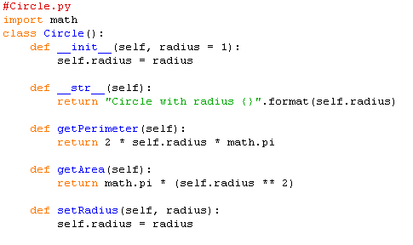
Encapsulation
When we use the class, we don’t have to know the detailed code inside the class
Details of the class
Dasar-Dasar Pemrograman Ganjil 2016-2017

Slide 24
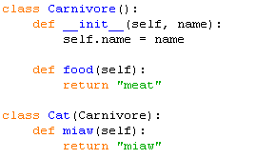

Inheritance
Cat inherits carnivore’s behavior
Dasar-Dasar Pemrograman Ganjil 2016-2017

Slide 25
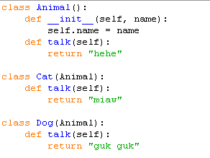

Polymorphism
Cat and Dog can talk in different words
Dasar-Dasar Pemrograman Ganjil 2016-2017

Slide 26
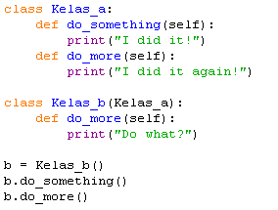
Excercise
Carilah output dari program di bawah ini!
Dasar-Dasar Pemrograman Ganjil 2016-2017

Slide 27
References
William Punch & Richard Enbody. The Practice of Computing using Python, 2nd Edition. Addison-Wesley, 2013
Y. Daniel Liang. Introduction to Programming Using Python. Prentice Hall, 2013.
John Zelle. Python Programming: An Introduction to Computer Science, 2nd Edition. Franklin, Beedle & Associates Inc., 2010.
Mark Lutz. Learning Python, 5th Edition. O’Reilly Media. Copyright 2013 Mark Lutz, 978-1-44-93-5573-9
L. Y. Stefanus. Slide Pelatihan Python. 2015.
Dasar-Dasar Pemrograman Ganjil 2016-2017

